Slide 1





7th IEEE International Conference INDISCON 2026
Paper Title:- LoRA-Based Resource-Efficient LLM Adaptation for RTL Hardware Trojan Detection
Paper ID:- 2211
Authors Name-DEBOPAM SINHA
Presented by : DEBOPAM SINHA
Department of Electronics and Communication Engineering
PES University RR Campus, Bengaluru, India
debopamsinha120@gmail.com
7th IEEE International Conference INDISCON 2026, 11th – 13th September 2026 | MNIT Jaipur, India

Slide 2
Presentation Outline
Introduction and Motivation
Background
Proposed Work
Dataset Description
Performance Measures
Results and Analysis
Conclusion and Future Scope
References
7th IEEE International Conference INDISCON 2026, 11th – 13th September 2026 | MNIT Jaipur, India

Slide 3
Introduction
Why RTL Hardware Trojan Detection?
Hardware Trojans (HTs) are malicious modifications that may remain dormant during normal verification.
RTL analysis enables security assessment before synthesis and physical implementation.
Conventional detection approaches can struggle with complex, obfuscated RTL designs.
Recent LLM-based approaches show potential for understanding RTL structure.
However, adapting LLMs can require significant computational resources.
7th IEEE International Conference INDISCON 2026, 11th – 13th September 2026 | MNIT Jaipur, India

Slide 4
Background
Hardware Trojan
Malicious modification of an RTL design
Typically consists of:
Trigger — activates the Trojan under specific conditions .
Payload — performs the malicious action.
Why LLMs for RTL?
Verilog/RTL is a structured representation of hardware.
Transformer-based models can learn relationships within serialized RTL.
Recent work has explored LLMs for Trojan detection and localization
7th IEEE International Conference INDISCON 2026, 11th – 13th September 2026 | MNIT Jaipur, India

Slide 5
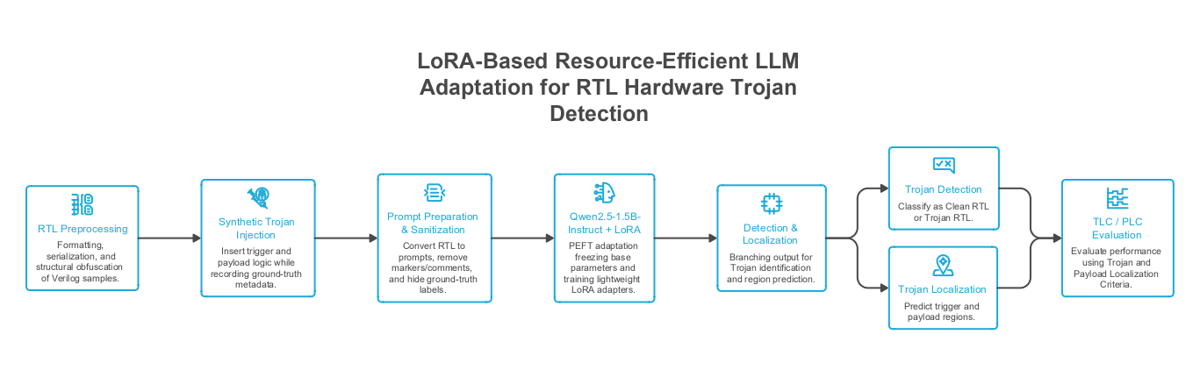
Proposed Work
7th IEEE International Conference INDISCON 2026, 11th – 13th September 2026 | MNIT Jaipur, India

Slide 6
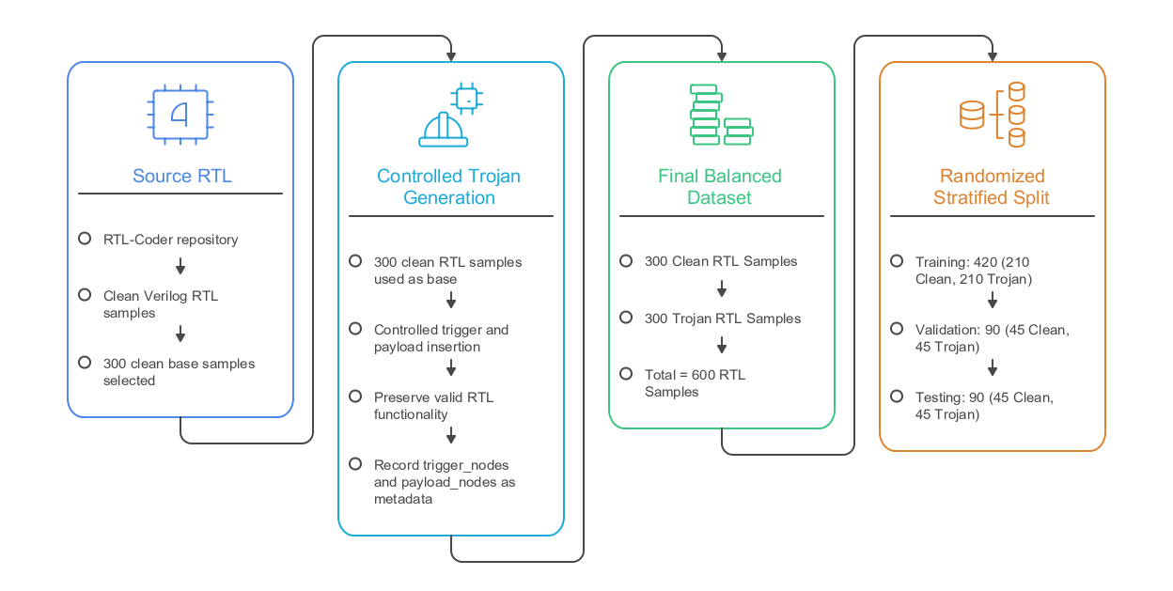
Dataset Description
7th IEEE International Conference INDISCON 2026, 11th – 13th September 2026 | MNIT Jaipur, India

Slide 7
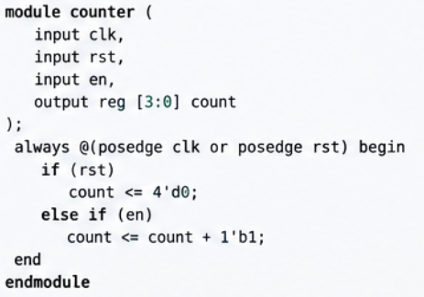
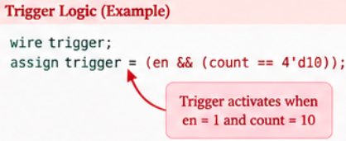
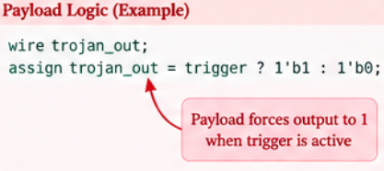
Verilog Example - Clean File
Trigger and Payload Logic
7th IEEE International Conference INDISCON 2026, 11th – 13th September 2026 | MNIT Jaipur, India

Slide 8
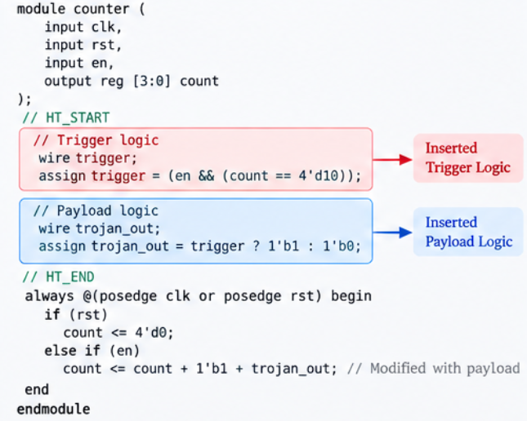
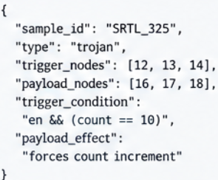
Code after Trojan Insertion - Before Model Training
Metadata Stored to Compare TLC and PLC
7th IEEE International Conference INDISCON 2026, 11th – 13th September 2026 | MNIT Jaipur, India

Slide 9
Performance Measures
  Table 1 : Details of Experiment
Component | Configuration
Base Model | Qwen 2.5 — 1.5B Instruct
Adaptation | LoRA- based PEFT
Percision | FP16
LoRA Rank | 8
Learning Rate | 2 x 10⁴
Batch Size | 1
Gradient Accumulation | 8
Epochs | 3
Trainable Parameters | 2.17M (0.141%)
GPU | NVIDIA Tesla T4
Runtime | Approx 6 min
7th IEEE International Conference INDISCON 2026, 11th – 13th September 2026 | MNIT Jaipur, India

Slide 10


Performance Measures
Table 2 : General Metrics
Metric | Purpose
Accuracy | Overall classification correctness
Precision | Reliability of Trojan Predictions
Recall | Ability to detect Trojan Samples
F1-Score | Balanced percision-recall measure
Table 3 : Localization Metrics
Localization Metric | Purpose
Trigger Localization Coverage | Measures overlap between predicted Trigger nodes and ground-truth trigger nodes
Payload Localization Coverage | Measures overlap between predicted Payload nodes and ground-truth payload nodes
7th IEEE International Conference INDISCON 2026, 11th – 13th September 2026 | MNIT Jaipur, India

Slide 11
Results and Analysis
Table 4 : General Metrics
Table 5 : Confusion Matrix
Metric | Result
Accuracy | 98.89%
Percision | 100.00%
Recall | 97.78%
F-1 Score | 98.88%
 | Predicted Clean | Predicted Trojan
Actual Clean | 45 | 0
Actual Trojan | 1 | 44
Table 6 : Localization Metric result
Table 7 : Resource Effeciency
Metric | Result
Trigger Localization Coverage (TLC) | 98.89%
Payload Localization Coverage (PLC) | 98.89%
Aspect | Proposed
Adaptation | LoRA-based PEFT
GPU | Tesla T4
Platform | Google Colab
Trainable Parameters | 2.17M
Runtime | 6 min approx
7th IEEE International Conference INDISCON 2026, 11th – 13th September 2026 | MNIT Jaipur, India

Slide 12
Conclusions and Future Scope
Conclusions :
Developed a LoRA-based, resource-efficient framework for RTL Hardware Trojan detection and localization.
Combined controlled Trojan generation, prompt sanitization, and parameter-efficient LLM adaptation.
Achieved 98.89% accuracy and 98.88% F1-score on the controlled test set.
Achieved 98.89% TLC and 98.89% PLC for trigger and payload localization.
Training required only 0.141% trainable parameters and was executed on an NVIDIA Tesla T4.
Future Scope :
Evaluate on larger and heterogeneous RTL benchmarks.
Incorporate real-world Hardware Trojan datasets.
Introduce template-level separation to better assess generalization.
Extend evaluation to gate-level and post-synthesis analysis.
Explore broader LLM-based hardware security tasks.
7th IEEE International Conference INDISCON 2026, 11th – 13th September 2026 | MNIT Jaipur, India

Slide 13
References
Kundu et al., “PEARL: An Adaptive and Explainable Hardware Trojan Detection Using Open-Source and Enterprise Large Language Models,” IEEE Access, 2025.
Faruque et al., “TrojanWhisper: Evaluating Pre-trained LLMs to Detect and Localize Hardware Trojans,” IEEE Access, 2026.
Hu et al., “LoRA: Low-Rank Adaptation of Large Language Models,” ICLR, 2022.
Wan et al., “Assessment of Pre-trained Large Language Models for Hardware Trojan Detection in RTL Designs,” LAD, 2024.
Liu et al., “RTL-Coder: A New LLM Solution for RTL Code Generation,” 2024.
Tehranipoor & Koushanfar, “A Survey of Hardware Trojan Taxonomy and Detection,” IEEE Design & Test of Computers, 2010.
7th IEEE International Conference INDISCON 2026, 11th – 13th September 2026 | MNIT Jaipur, India

Slide 14
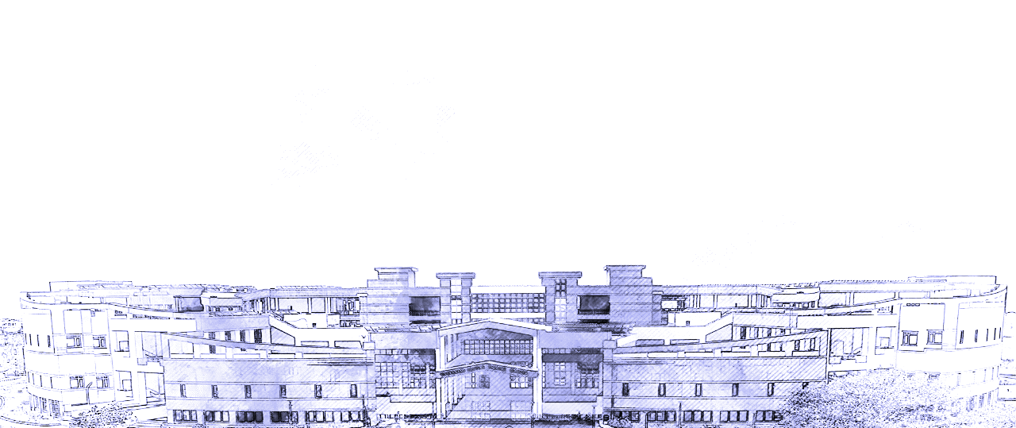
THANK YOU

